Slide 1
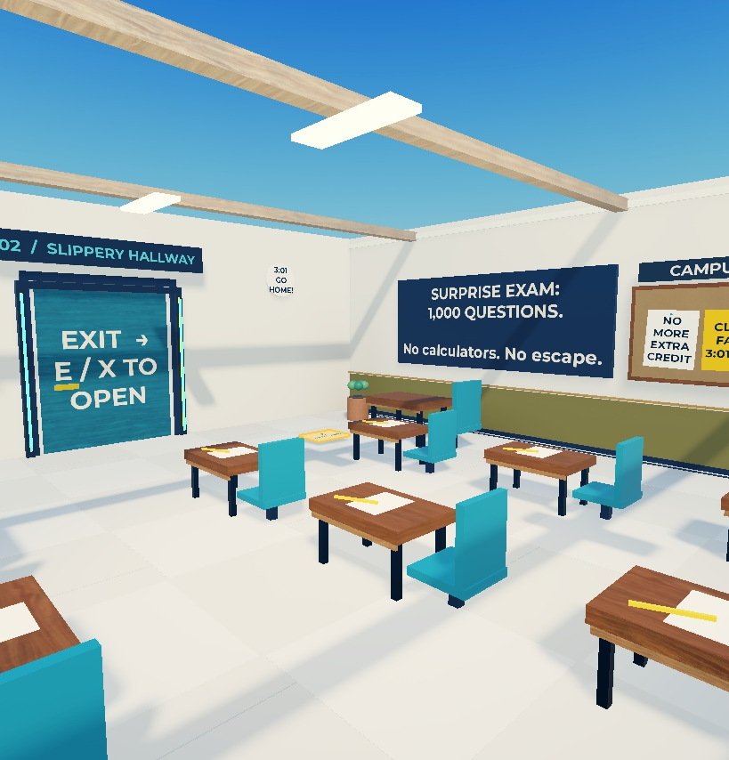
A ROBLOX GAME PROJECT
ESCAPE THE
PROFESSOR!
A school escape game with
obstacles, quizzes, and a chase.
Peace Funso-Ore
James Hunter
Emaury Onyeneho
Tobenna Uyanwune
CLASS PRESENTATION / OCTOBER 5, 2026
Notes:
PRESENTER: Peace Funso-Ore
TIME: 35 seconds
Hi, we are Peace, James, Emaury, and Tobenna. Our project is ESCAPE THE PROFESSOR, a Roblox school escape game. The joke is that school has ended, but the professor has assigned one thousand questions. The player has to escape through six rooms and reach the school bus. We will explain the game design, show how some of the real code works, and discuss the bugs and improvements.
SOURCE: C:\Users\toben\OneDrive\Documents\ChatGPT\Rojo\src\shared\Config.luau
Screenshot: local Campus Upgrade classroom, captured in Roblox Studio.

Slide 2
ESCAPE THE PROFESSOR!
Our assigned project roles
Peace Funso-Ore
Game design
Rules, room order, checkpoints
James Hunter
Programming
Luau, progression, quiz logic
Emaury Onyeneho
Visuals and interface
School design, professor, HUD
Tobenna Uyanwune
Testing and improvements
Bug fixes, chase balance, demo
Peace Funso-Ore
02
Notes:
PRESENTER: Peace Funso-Ore
TIME: 35 seconds
For this presentation, each person has a project responsibility. I am the game design lead, so I will explain the rules and the order of the rooms. James is the programming lead and will explain how the server runs the game. Emaury is the visual and interface lead, explaining the school, character, and screen layout. Tobenna is the testing and improvement lead, covering bugs, difficulty, and our demonstration. These are our assigned responsibilities for understanding and presenting the project.
PROJECT SOURCES
Screenshots show the local Campus Upgrade game. Camera framing is staged for clarity.

Slide 3
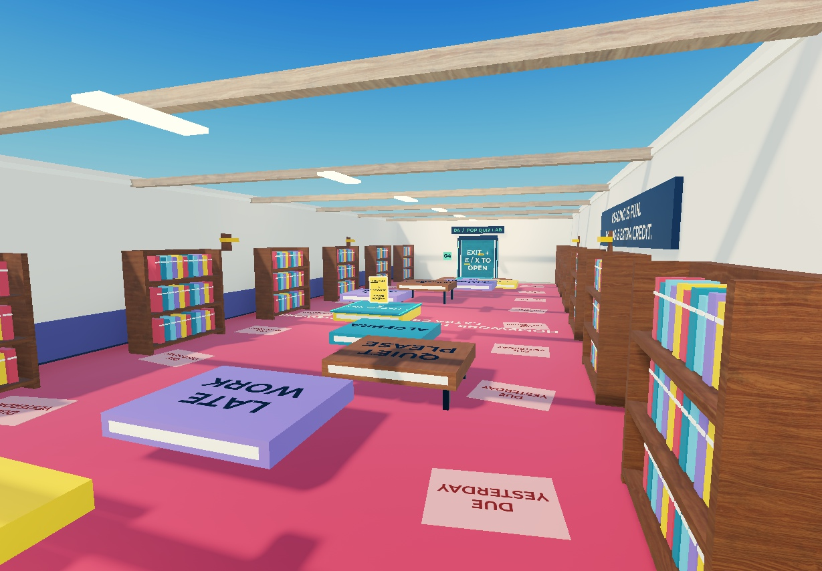
ESCAPE THE PROFESSOR!
Six rooms to reach the bus
01
Classroom
Collect 3 homework sheets
02
Hallway
Dodge moving pencils
03
Library
Jump across giant books
04
Quiz lab
Answer 3 questions
05
Staff room
Take the exit key
06
Final bell
Escape to the school bus
Room 3: The Floor Is Homework
Peace Funso-Ore
03
Notes:
PRESENTER: Peace Funso-Ore
TIME: 35 seconds
The rooms change the type of challenge as the player moves forward. First, find three homework sheets. Next, dodge the pencils in the hallway. The library turns books into a jumping course. The science room adds a three-question quiz. Then the player sneaks past the professor to collect an exit key. The final room combines weaving, jumping, and sprinting. The giant books and school jokes make ordinary school objects part of the obstacle course.
PROJECT SOURCES
C:\Users\toben\OneDrive\Documents\ChatGPT\Rojo\src\shared\Config.luau
C:\Users\toben\OneDrive\Documents\ChatGPT\Rojo\studio\BuildMap.luau
Screenshots show the local Campus Upgrade game. Camera framing is staged for clarity.

Slide 4
ESCAPE THE PROFESSOR!
Progress, retry, and replay
A clear goal
A useful retry
Complete the room objective
to unlock the next stage.
Return to checkpoints after
a fall or a catch.
An optional challenge
A reason to replay
Find 6 hidden hall passes
without blocking your escape.
Manage stamina, improve your
time, and earn a better grade.
Peace Funso-Ore
04
Notes:
PRESENTER: Peace Funso-Ore
TIME: 40 seconds
The player always has a current objective. Completing it opens the next part of the school. Checkpoints help a mistake feel recoverable, because the player returns to a saved point. Six optional hall passes encourage exploration, but the player does not need them to escape. Sprinting uses stamina, so holding the run button forever will not work. At the end, players receive a grade based on time and catches and can replay to improve their session best. James will explain how the code controls these rules.
PROJECT SOURCES
C:\Users\toben\OneDrive\Documents\ChatGPT\Rojo\src\server\Progression.luau
C:\Users\toben\OneDrive\Documents\ChatGPT\Rojo\src\shared\Config.luau
C:\Users\toben\OneDrive\Documents\ChatGPT\Rojo\src\server\Main.server.luau
Screenshots show the local Campus Upgrade game. Camera framing is staged for clarity.

Slide 5
ESCAPE THE PROFESSOR!
How the project fits together
LOCAL SOURCE
STUDIO DESTINATION
src/server
ServerScriptService.EscapeServer
src/client
StarterPlayerScripts.EscapeClient
src/shared
ReplicatedStorage.EscapeShared
Rojo syncs the scripts. The complete .rbxl file also stores the school and professor model.
Tools: Roblox Studio, Luau, Rojo, and AI-assisted development
James Hunter
05
Notes:
PRESENTER: James Hunter
TIME: 40 seconds
Roblox Studio holds the school and runs the game. Luau is the programming language. Rojo syncs our local code files into the correct Studio folders. The server controls progress, catches, and correct answers. The client handles input, the interface, and effects. Shared files hold settings used by both. We edit the source files on the computer so Rojo keeps them in sync. The project used AI assistance for development and debugging. Understanding and checking the code is part of our responsibility.
PROJECT SOURCES
C:\Users\toben\OneDrive\Documents\ChatGPT\Rojo\default.project.json
C:\Users\toben\OneDrive\Documents\ChatGPT\Rojo\src\server\Main.server.luau
C:\Users\toben\OneDrive\Documents\ChatGPT\Rojo\src\client\Main.client.luau
Screenshots show the local Campus Upgrade game. Camera framing is staged for clarity.

Slide 6
ESCAPE THE PROFESSOR!
Code: the classroom exit
if s.Homework < 3 then
P.Send(player, 'Toast', {
Text = 'Find all 3 homework sheets first.',
Tone = 'bad'
})
return
end
P.Stage(player, 2, 'HallStart')
Condition
Check the homework count.
Early return
Stop until the requirement is complete.
James Hunter
06
Notes:
PRESENTER: James Hunter
TIME: 45 seconds
This is real code from the interaction script, with extra spacing to make it readable. The variable s stores the player state. The if statement checks whether Homework is below three. If it is, the server sends a message and return stops this action. Once the player has three sheets, the program reaches P.Stage. That function advances the player to stage two and uses the HallStart checkpoint. The check runs on the server, so the interface alone cannot decide that the player has completed a room.
PROJECT SOURCES
C:\Users\toben\OneDrive\Documents\ChatGPT\Rojo\src\server\Interactions.luau
C:\Users\toben\OneDrive\Documents\ChatGPT\Rojo\src\server\Progression.luau
Screenshots show the local Campus Upgrade game. Camera framing is staged for clarity.

Slide 7
ESCAPE THE PROFESSOR!
Code: a different quiz each run
9 questions in the bank. 3 questions per run.
local order = {1, 2, 3}
for i = 3, 2, -1 do
local j = random:NextInteger(1, i)
order[i], order[j] = order[j], order[i]
end
The loop swaps answer positions before the player sees them.
James Hunter
07
Notes:
PRESENTER: James Hunter
TIME: 45 seconds
The quiz contains nine possible questions. Each run selects one math question, one science question, and one school-survival question. This loop shuffles the answer positions. The list starts with one, two, and three. The loop chooses a random position and swaps two entries. This means the correct answer does not always appear on the same button. Correct answers remain on the server, and a cooldown discourages clicking every answer instantly. Emaury will now explain how the game communicates these challenges visually.
PROJECT SOURCES
C:\Users\toben\OneDrive\Documents\ChatGPT\Rojo\src\server\Quiz.luau
C:\Users\toben\OneDrive\Documents\ChatGPT\Rojo\src\server\Interactions.luau
Screenshots show the local Campus Upgrade game. Camera framing is staged for clarity.

Slide 8
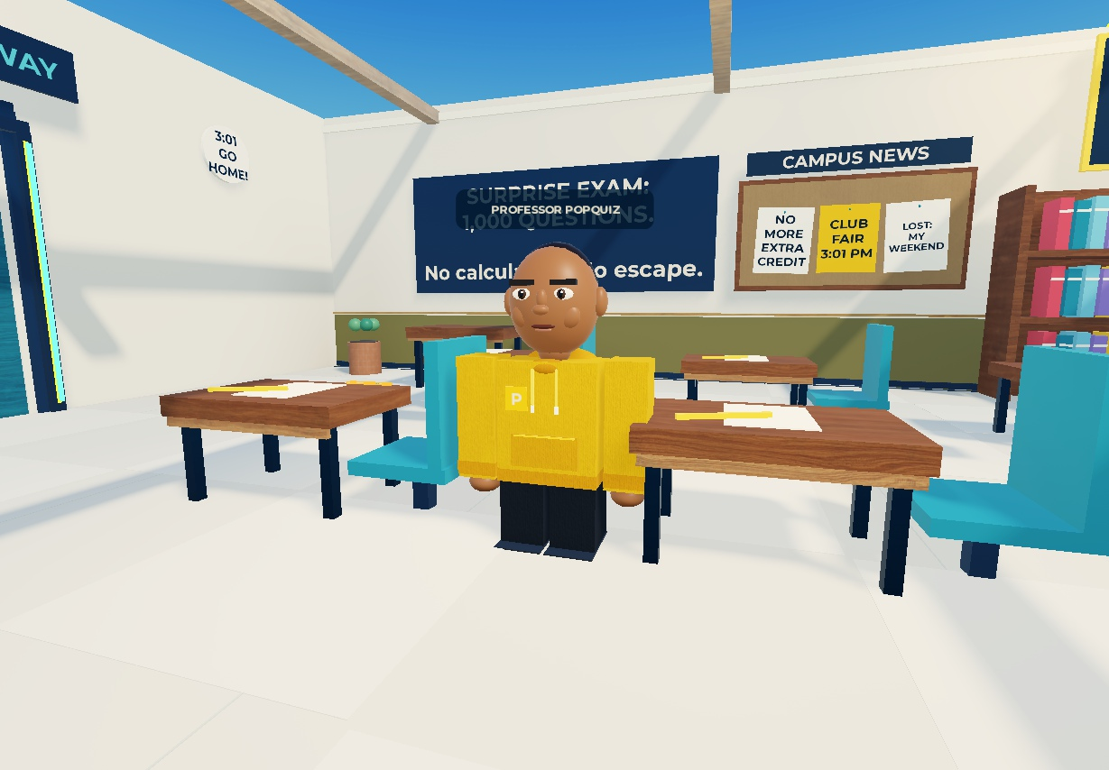
ESCAPE THE PROFESSOR!
Professor Popquiz
Recognizable silhouette
Yellow hoodie and dark trousers
stand out against the school.
A playful threat
A school-themed pursuer with
lines about extra credit.
Emaury Onyeneho
08
Notes:
PRESENTER: Emaury Onyeneho
TIME: 40 seconds
Our professor is a stylized Roblox character with a bright yellow hoodie, dark trousers, and a recognizable face. The design follows the appearance reference chosen for the project. The yellow color makes him easy to spot inside the school. His exaggerated school dialogue keeps the tone funny. The model in this image is the actual professor asset, staged in the classroom for a clear view. His movement and catching behavior come from a separate AI script.
PROJECT SOURCES
C:\Users\toben\OneDrive\Documents\ChatGPT\Rojo\studio\VisualUpgrade.luau
C:\Users\toben\OneDrive\Documents\ChatGPT\Rojo\src\server\ProfessorAI.luau
C:\Users\toben\OneDrive\Documents\ChatGPT\Rojo\src\shared\Config.luau
Screenshots show the local Campus Upgrade game. Camera framing is staged for clarity.

Slide 9
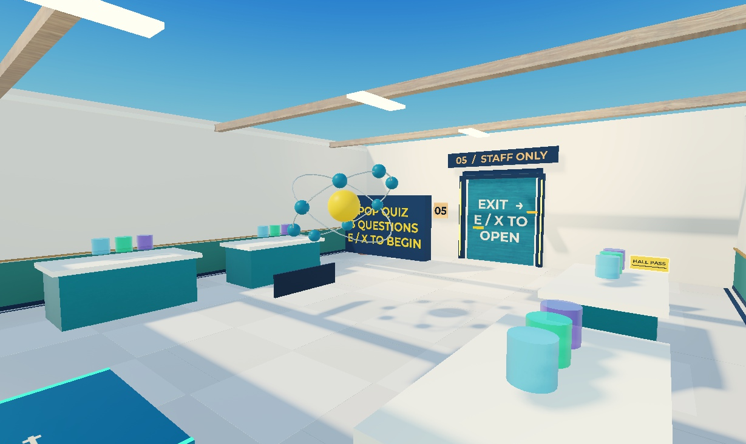
ESCAPE THE PROFESSOR!
A school that explains the game
Readable routes
Numbered doors and signs
point toward the next room.
Purposeful detail
Color, light, and school props
make objectives easier to find.
Emaury Onyeneho
09
Notes:
PRESENTER: Emaury Onyeneho
TIME: 35 seconds
The environment gives players clues without needing a long tutorial. Numbered doors show the room order, while posters connect the school theme to the next challenge. Glowing homework and a golden key attract attention to important items. Room colors help players recognize where they are. We also separate decoration from obstacles. New decorative pieces do not collide with players, so a poster or small visual detail should not unexpectedly block a route.
PROJECT SOURCES
C:\Users\toben\OneDrive\Documents\ChatGPT\Rojo\studio\CampusPolish.luau
C:\Users\toben\OneDrive\Documents\ChatGPT\Rojo\studio\VisualUpgrade.luau
Screenshots show the local Campus Upgrade game. Camera framing is staged for clarity.

Slide 10
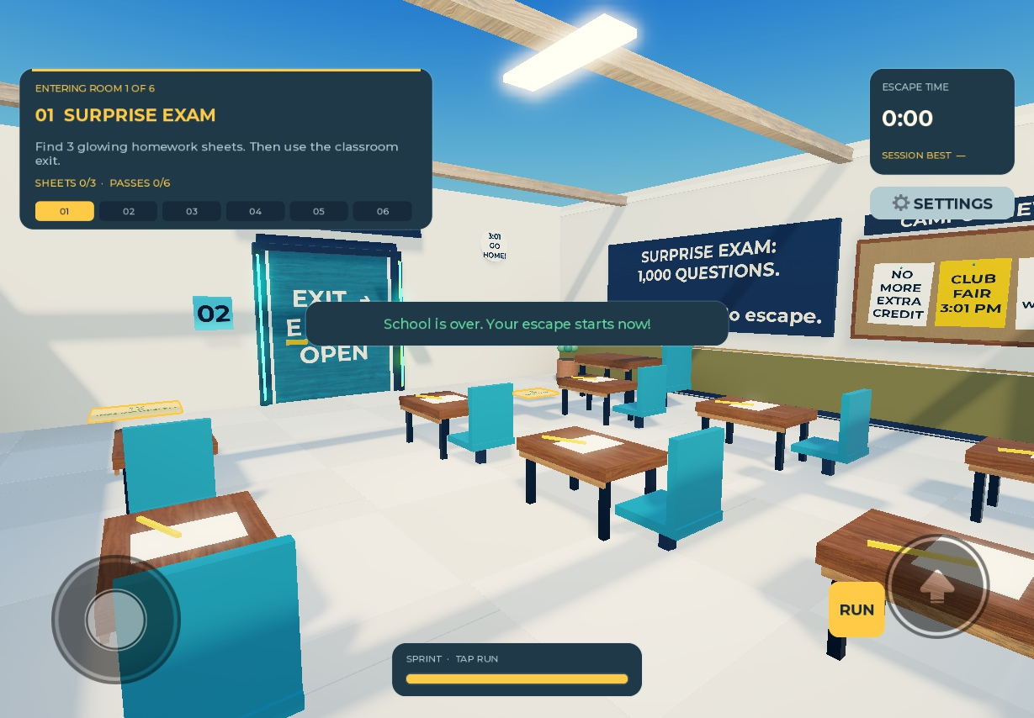
ESCAPE THE PROFESSOR!
The interface helps players decide
Objective and timer
Players can see the next task
and track their escape time.
Stamina bar
0 = empty
1 = full
math.clamp(value, 0, 1)
Stamina code appears in the appendix.
Emaury Onyeneho
10
Notes:
PRESENTER: Emaury Onyeneho
TIME: 40 seconds
The HUD is the information displayed while playing. It shows the room objective, collected items, time, and stamina. The interface also includes hints, sound effects, and reduced-motion settings. This small code example sets the width of the stamina bar. A value of one means full width, and zero means empty. math.clamp keeps the value inside that range. The bar displays the server state, while the server decides the actual sprint speed. Tobenna will explain what testing revealed.
PROJECT SOURCES
C:\Users\toben\OneDrive\Documents\ChatGPT\Rojo\src\client\UI.luau
C:\Users\toben\OneDrive\Documents\ChatGPT\Rojo\src\client\Main.client.luau
C:\Users\toben\OneDrive\Documents\ChatGPT\Rojo\src\server\Main.server.luau
Screenshots show the local Campus Upgrade game. Camera framing is staged for clarity.

Slide 11
ESCAPE THE PROFESSOR!
Testing checked rules and movement
100 quiz decks
All questions and answer positions appeared
6 progression checks
Room, quiz, and exit requirements passed
11 replay checks
Hall passes and session records passed
24-second patrols
Professor moved 225 studs without recovery
Controlled Studio checks. Physical phone and controller testing remain next steps.
Tobenna Uyanwune
11
Notes:
PRESENTER: Tobenna Uyanwune
TIME: 35 seconds
Testing needs to check more than whether the game opens. The project ran one hundred seeded quiz tests to check question variety, answer positions, and the information sent to the client. Progression checks tested room requirements, and replay checks tested collectibles and session records. Patrol checks watched the professor complete routes without getting stuck. The interface also received desktop and phone simulator checks. These results are useful evidence, but they do not replace watching new players or testing on physical phones.
PROJECT SOURCES
C:\Users\toben\OneDrive\Documents\ChatGPT\Rojo\CAMPUS_UPGRADE.md
C:\Users\toben\OneDrive\Documents\ChatGPT\Rojo\tests\StudioRegression.server.luau
Screenshots show the local Campus Upgrade game. Camera framing is staged for clarity.

Slide 12
ESCAPE THE PROFESSOR!
Bug fix: the professor faced a wall
Cause: navigation could target cabinet tops.
local function floorPoint(position)
local p = course:ToLocal(position)
return course:ToWorld(
Vector3.new(p.X, 41.15, p.Z)
)
end
Fix: use foot-level endpoints and preserve valid routes.
Tobenna Uyanwune
12
Notes:
PRESENTER: Tobenna Uyanwune
TIME: 40 seconds
One reported bug was that the professor stared at a wall instead of moving. A cause was the path calculation using a point near the body instead of the floor. That could produce a route onto cabinet tops. The fix puts the path endpoints at foot level. This function converts a position into course coordinates, sets its height to the floor, then converts it back to the world. The AI also keeps useful routes between updates and can recover if movement stalls. Later patrol tests completed without needing recovery.
PROJECT SOURCES
C:\Users\toben\OneDrive\Documents\ChatGPT\Rojo\src\server\ProfessorAI.luau
C:\Users\toben\OneDrive\Documents\ChatGPT\Rojo\CHASE_UPGRADE.md
C:\Users\toben\OneDrive\Documents\ChatGPT\Rojo\CAMPUS_UPGRADE.md
Screenshots show the local Campus Upgrade game. Camera framing is staged for clarity.

Slide 13
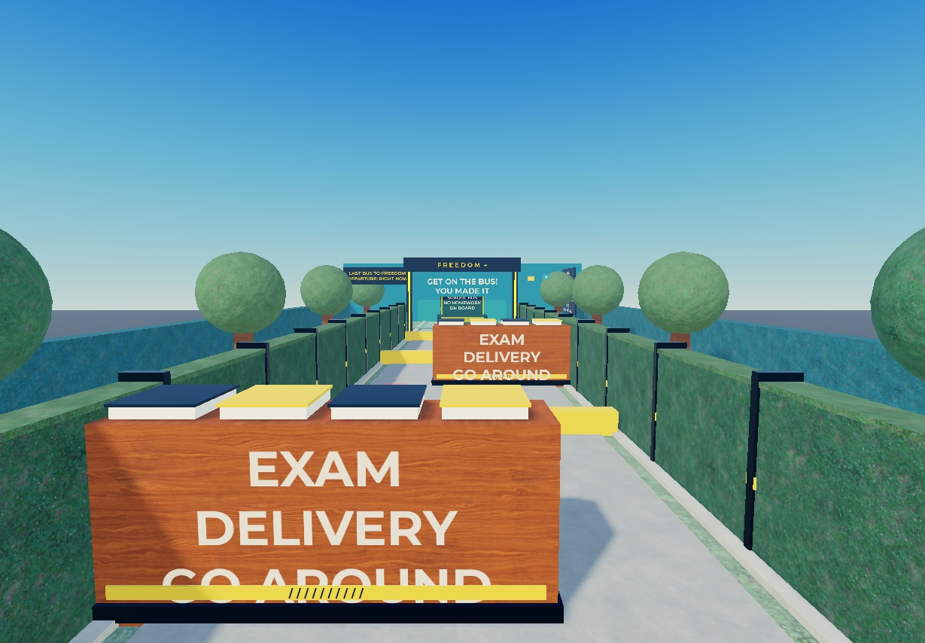
ESCAPE THE PROFESSOR!
The final chase now rewards timing
2 carts + 3 hurdles
A 1.8-second head start
before the professor accelerates.
8.1 s
Timed sprint: escaped
7.3 s
Walking: caught
Tobenna Uyanwune
13
Notes:
PRESENTER: Tobenna Uyanwune
TIME: 35 seconds
Another piece of feedback was that the ending felt too easy. The updated course uses alternating exam carts, three hurdles, and a professor who accelerates. The player gets a short head start and has to manage sprint stamina. In a controlled test, a timed sprint route escaped in 8.1 seconds, while a walking attempt got caught after 7.3 seconds. These are two different attempts, not average player scores. Newcomer playtests would help us judge whether the difficulty feels fair.
PROJECT SOURCES
C:\Users\toben\OneDrive\Documents\ChatGPT\Rojo\src\shared\Config.luau
C:\Users\toben\OneDrive\Documents\ChatGPT\Rojo\studio\ChaseUpgrade.luau
C:\Users\toben\OneDrive\Documents\ChatGPT\Rojo\CAMPUS_UPGRADE.md
Screenshots show the local Campus Upgrade game. Camera framing is staged for clarity.

Slide 14
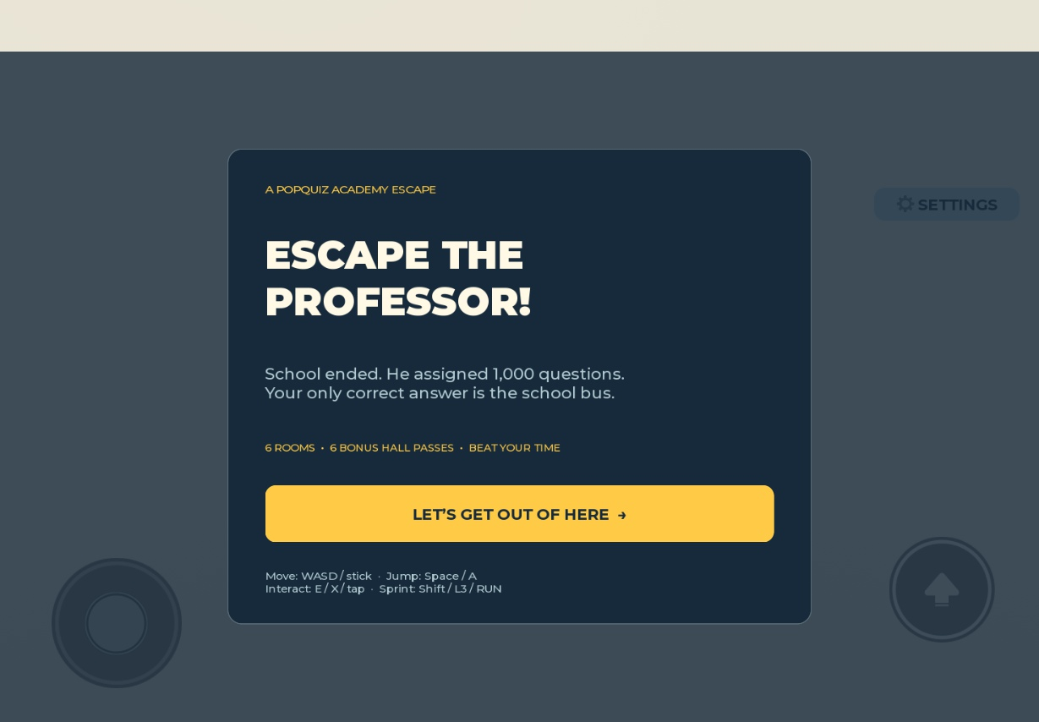
ESCAPE THE PROFESSOR!
Demo and what we learned
30-second demo
Start the game, show the objective,
and collect one homework sheet.
Next improvements
Test with new players and on
physical phones and controllers.
Open the published game
Tobenna Uyanwune
14
Notes:
PRESENTER: Tobenna Uyanwune
TIME: 35 seconds
For our short demo, we will start the game, point out the objective and stamina bar, and collect one homework sheet. The full game takes longer than this presentation, so the screenshots show the later rooms. Our main lesson is that rules, visuals, and testing all affect how a game feels. A pathfinding bug can stop a chase even when the character looks finished. Next, we would test with more new players and on real phones and controllers. Thank you. We are ready for questions.
PROJECT SOURCES
C:\Users\toben\OneDrive\Documents\ChatGPT\Rojo\CAMPUS_UPGRADE.md
C:\Users\toben\OneDrive\Documents\ChatGPT\Rojo\PUBLISH_STATUS.md
Screenshots show the local Campus Upgrade game. Camera framing is staged for clarity.

Slide 15
APPENDIX / REFERENCE
Source files and responsibilities
Server: 5 files
Client: 4 files
Main, Progression, Interactions,
ProfessorAI, Quiz
Main, UI, Effects, Guidance
Shared: 2 files
Scene and checks
Config sets rules.
Course handles map coordinates.
studio/ contains map recipes.
tests/ contains regression checks.
The complete source and saved game are in the companion ZIP.
All presenters
15
Notes:
PRESENTER: All presenters
TIME: Reference only, skip during main talk
Reference for questions. The companion ZIP contains all production source files, edit-time map recipes, a regression script, the Rojo configuration, and the complete saved place. Do not run the test script in the published game. A scripts-only Rojo build does not include the map. The role assignments describe presentation and maintenance responsibilities, not an assertion of who originally typed each line.
PROJECT SOURCES
C:\Users\toben\OneDrive\Documents\ChatGPT\Rojo\default.project.json
C:\Users\toben\OneDrive\Documents\ChatGPT\Rojo\WORKFLOW.md
Screenshots show the local Campus Upgrade game. Camera framing is staged for clarity.

Slide 16
APPENDIX / REFERENCE
Code reference: stamina display
ui.Stamina.Size = UDim2.fromScale(
math.clamp(state.Stamina or 1, 0, 1),
1
)
Width follows stamina. Height stays at 100%.
The server controls stamina consumption and movement speed.
Emaury Onyeneho
16
Notes:
PRESENTER: Emaury Onyeneho
TIME: Reference only, skip during main talk
This is the actual stamina display expression from Main.client.luau, expanded for readability. UDim2.fromScale uses a fraction of the parent size. The first value sets width and the second sets height. math.clamp limits stamina to the interval zero through one. The or 1 expression provides a full bar if no stamina value is available yet. This is display code. Server/Main.server.luau drains and recovers stamina and sets Humanoid.WalkSpeed.
PROJECT SOURCES
C:\Users\toben\OneDrive\Documents\ChatGPT\Rojo\src\client\Main.client.luau
C:\Users\toben\OneDrive\Documents\ChatGPT\Rojo\src\server\Main.server.luau
Screenshots show the local Campus Upgrade game. Camera framing is staged for clarity.

Slide 17
APPENDIX / REFERENCE
Code reference: quiz answer validation
if index == question.Correct then
s.Quiz += 1
s.QuizUntil = t + 0.85
P.Push(player)
-- Feedback follows in the full function.
Excerpt: the full function also validates distance, stage,
answer range, and cooldown before accepting an answer.
James Hunter
17
Notes:
PRESENTER: James Hunter
TIME: Reference only, skip during main talk
This excerpt shows the successful-answer branch from Interactions.luau. The server compares the submitted button index with question.Correct. It increases the number of correct answers, sets a short cooldown, and pushes the new state to the player. The complete function also checks the player stage, distance to the board, answer type, allowed index, and timing. Quiz.View sends only the visible question, answer choices, index, total, and subject. It does not send the correct answer before the player responds.
PROJECT SOURCES
C:\Users\toben\OneDrive\Documents\ChatGPT\Rojo\src\server\Interactions.luau
C:\Users\toben\OneDrive\Documents\ChatGPT\Rojo\src\server\Quiz.luau
Screenshots show the local Campus Upgrade game. Camera framing is staged for clarity.

